Slide 1
Bayesian Neural Networks vs Traditional Neural Networks
Sarah Beaver
Mica Haney

Slide 2
Premise
The goal of the project is to look at how well a Bayesian neural network performs in comparison to a regular neural network.
Regular neural networks just output a prediction, while a Bayesian network also provides a confidence interval. Having a confidence interval increases trust and understanding of predicted results. However, it’s not a great benefit if the Bayesian network does worse. If it were superior or even just comparable to a regular neural network, it would beg the question of why we don’t see more of Bayesian neural networks.

Slide 3
Data
Data was collected from the All Of Us Research Program corpus. It is a database of health information collected from volunteers. Surveys, tests, any sort of health records are collected.
This project focused on surveys about demographics and lifestyle, and collects records from patients who at some point contract heart disease, diabetes type 1 or type 2, arthritis (including Rheumatoid and ​​Osteo), and high blood pressure (hypertension).
Each patient’s data is compressed so that there is only one record per person.
The final dataset contained 13,805 rows with 24 features and 4 targets. It was split for train/validation/test in a 56/24/20 ratio.

Slide 4
Data: Description
 | count | unique | top | freq |  | count | unique | top | freq
gender | 13540 | 2 | Female | 7460 | Overall Health: Difficult Understand Info | 13404 | 5 | Difficult Understand Info: Never | 7843
race | 13493 | 7 | White | 7161 | Overall Health: Everyday Activities | 13522 | 5 | Everyday Activities: Completely | 4078
ethnicity | 13493 | 3 | Not Hispanic or Latino | 10314 | Overall Health: General Mental Health | 13522 | 6 | General Mental Health: Good | 4229
Alcohol: Alcohol Participant | 13505 | 2 | Alcohol Participant: Yes | 11814 | Overall Health: General Physical Health | 13430 | 5 | General Physical Health: Fair | 5015
Cigar Smoking: Cigar Smoke Participant | 13402 | 3 | Cigar Smoke Participant: No | 8681 | Overall Health: General Social | 13460 | 5 | General Social: Good | 4226
Education Level: Highest Grade | 13476 | 4 | Highest Grade: College One to Three | 4602 | Overall Health: Health Material Assistance | 13498 | 5 | Health Material Assistance: Never | 7131
Electronic Smoking: Electric Smoke Participant | 13466 | 3 | Electric Smoke Participant: No | 11711 | Overall Health: Organ Transplant | 13533 | 3 | Organ Transplant: No | 12461
Employment: Employment Status | 13487 | 2 | Not currently employed for wages | 10189 | Overall Health: Social Satisfaction | 13523 | 5 | Social Satisfaction: Good | 4370
Home Own: Current Home Own | 13335 | 4 | Current Home Own: Rent | 6220 | Smokeless Tobacco: Smokeless Tobacco Participant | 13458 | 3 | Smokeless Tobacco Participant: No | 12299
Hookah Smoking: Hookah Smoke Participant | 13452 | 3 | Hookah Smoke Participant: No | 12137 | Smoking: 100 Cigs Lifetime | 13557 | 3 | 100 Cigs Lifetime: No | 7006
Living Situation: How Many Living Years | 13608 | 6 | How Many Living Years: more 20 | 3124 | Obstructive sleep apnea (adult) (pediatric) | 13805 | 2 | No | 7175
Living Situation: How Many People | 13303 | 12 | 1 | 4818 | Type 2 diabetes mellitus with hyperglycemia | 13805 | 2 | Yes | 6977
Living Situation: Stable House Concern | 13575 | 2 | Stable House Concern: No | 11022 | Acute myocardial infarction, unspecified | 13805 | 2 | No | 13665
Marital Status: Current Marital Status | 13474 | 6 | Current Marital Status: Married | 5579 | Rheumatoid arthritis with rheumatoid factor, unspecified | 13805 | 2 | No | 13747

Slide 5
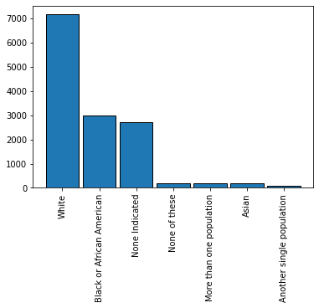
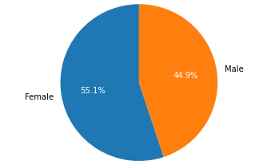
Data: Demographics

Slide 6
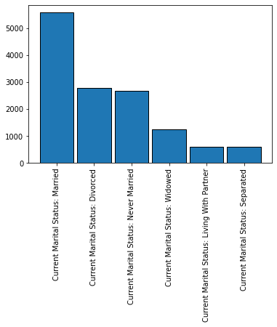
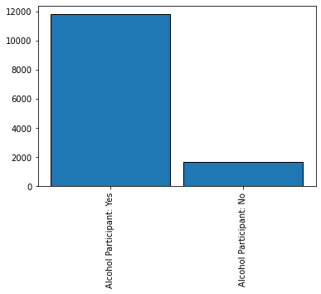
Data: Demographics

Slide 7
Deep Neural Network
 | 4 Disease Output
Normalization | True
Num. Layers | 3
Units 0 | 352
Units 1 | 128
Units 2 | 256
Activation | sigmoid
Final Activation | softmax
Dropout | True
Drop Rate | 0.2
LR | 0.0005290651
Accuracy | 0.6219007673
The final deep neural network wound up being a 3 layer neural network with sigmoid activations on interior layers, a softmax final activation, dropout at a rate of 0.2, and with a learning rate of 5.29 e.

Slide 8
Deep Neural Network
 | Sleep Apnea | Heart Attack Output | Arthritis | Diabetes
Normalization | True | False | True | False
Num. Layers | 1 | 3 | 1 | 3
Units 0 | 192 | 96 | 384 | 480
Units 1 | - | 160 | - | 224
Units 2 | - | 480 | - | 32
Activation | relu | tanh | tanh | relu
Final Activation | sigmoid | sigmoid | sigmoid | sigmoid
Dropout | True | False | True | True
Drop Rate | 0.1 | - | 0.1 | 0.0
LR | 0.000118748180 | 0.000127979 | 0.00028322456 | 0.00436188744
Accuracy | 0.61998114585 | 0.682352936 | 0.5785714149 | 0.6186481595

Slide 9
Bayesian Neural Network
 | 4 Disease Output
Normalization | False
Num. Layers | 2
Units 0 | 96
Units 1 | 384
Units 2 | -
Activation | sigmoid
Final Activation | sigmoid
Dropout | True
Drop Rate | 0.2
LR | 0.000250228668797638
Accuracy | 0.6150801062583924
This is the result of the Bayesian Neural Network using DenseVarational layers.

Slide 10
Bayesian Neural Network
 | 4 Disease Output
Normalization | True
Num. Layers | 1
Units 0 | 416
Units 1 | -
Units 2 | -
Activation | tanh
Final Activation | sigmoid
Dropout | True
Drop Rate | 0.2
LR | 0.001401704879812024
Accuracy | 0.6278352810310364
This is the result of the Bayesian Neural Network using DenseFlipout layers.

Slide 11
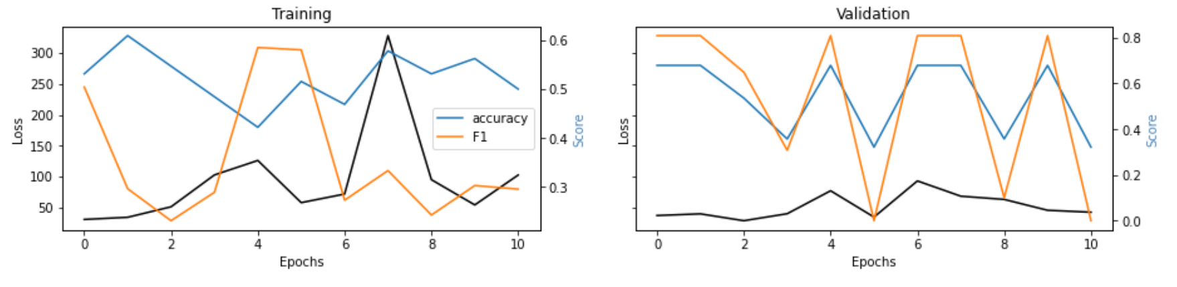
Results
On the whole results were bad. Accuracy never got above 65 on our final models, and was often worse on the various experiments. Viewing some of the training graphs immediately proved that some of these models were very bad.

Slide 12
Conclusion
All three final models performed essentially the same, with the Bayesian Neural Network with DenseFlipout layers performing ever so slightly better than the others, with an accuracy improvement of 0.00593451373103604.
On this dataset, both model types perform equally poorly.

Slide 13
Questions?

